Slide 1
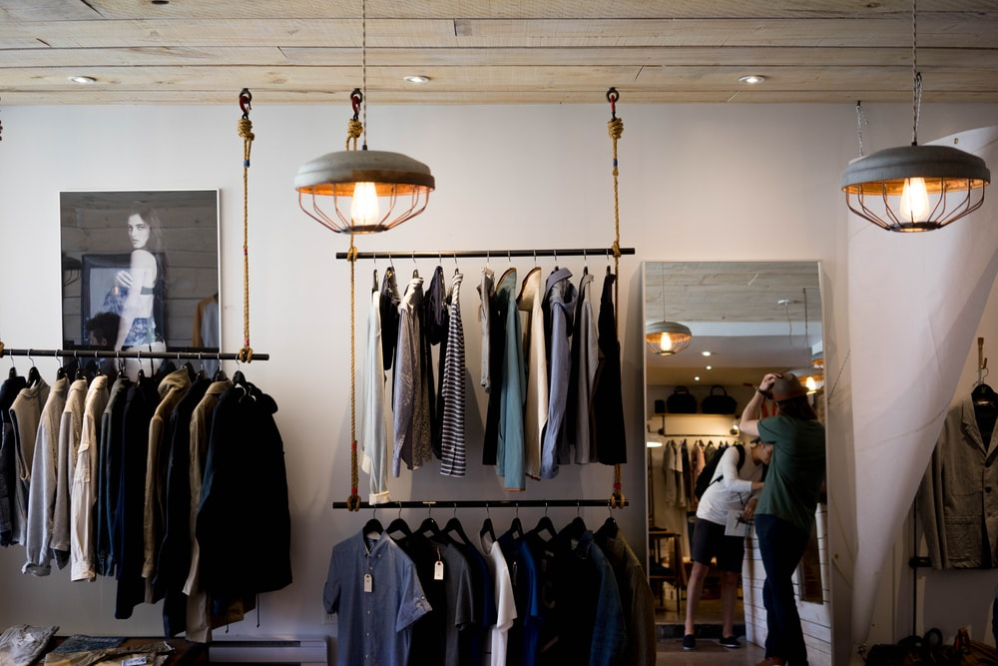

Retail Customer Churn
Case Study
Anish Mahapatra | 07 April, 2022

Slide 2

Agenda
01
Use-case analysis
02
Representation of problem
03
Analysis of hypotheses
04
Proposed Architecture and approach
05
Possible Solutions
06
Key Takeaways

Slide 3


Topic 1 of 6
Retail Loyalty Use-Case
Current State
Desired Future State
Current State
Stakeholders and Roles & Responsibilities
The customer relationship management team of a retail giant is responsible to retain customers and build loyalty to prevent customer churn
Current Scenario
The customer churn rate might endanger future growth as the customer acquisition rate in the retail market is high
Expectations
The team would like to identify the customers that are most likely to churn, especially in the upcoming quarter to sustain market presence
Outcomes
The team has knowledge of ways to reduce the customer churn rate by x%
Behaviour
Using the acquired knowledge, the team has been able to develop strategies to reduce customer churn rate and increase customer loyalty
Insight
The customer base has increased and the company has differentiated itself in the market

Slide 4
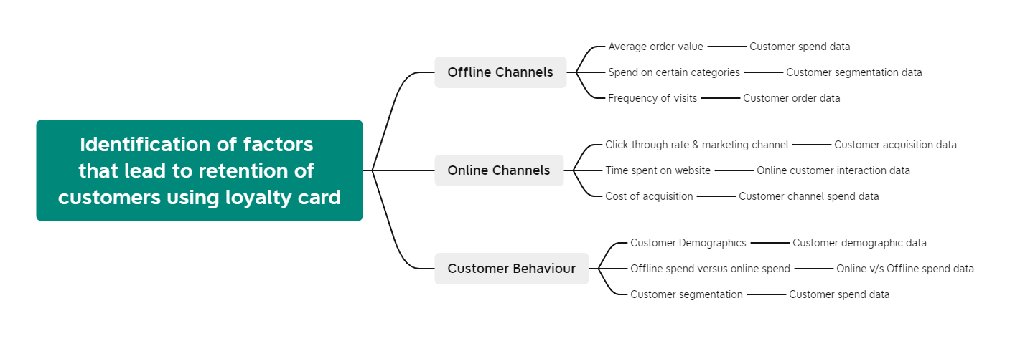


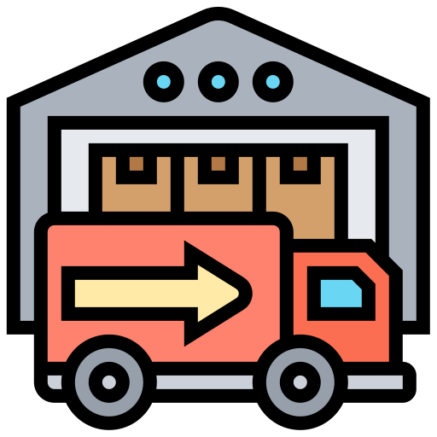
Topic 2 of 6
Representation of Hypotheses

Slide 5

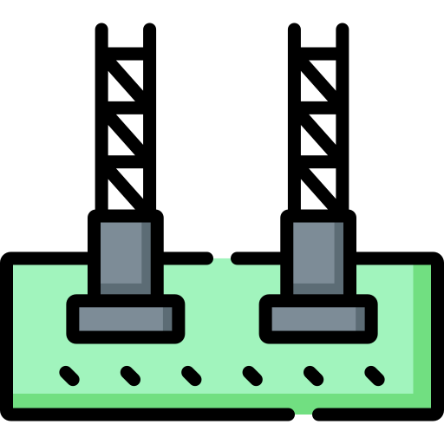




Topic 3 of 6
Analysis of Hypotheses
01
04
Average Order value
& other KRA
Customer Engagement
At what level is the customer engaged with the business, how to further engage the customer
What are the success metrics for a business to measure customer loyalty?
02
05
Loyalty level of customer
Customer Sentiment
Is the customer happy with the service, what is the CSAT score and what is the reason?
Frequency of visits and how long the customer has been with the brand
03
06
Regular Spend v/s Holiday Spend
Customer lifetime value
What is the customer lifetime value – how to set up & distribute the loyalty card and the corresponding points?
What is the reason they are spending?
Holiday, Anniversary, Regular, Family, Bachelor – how to offer customized options

Slide 6


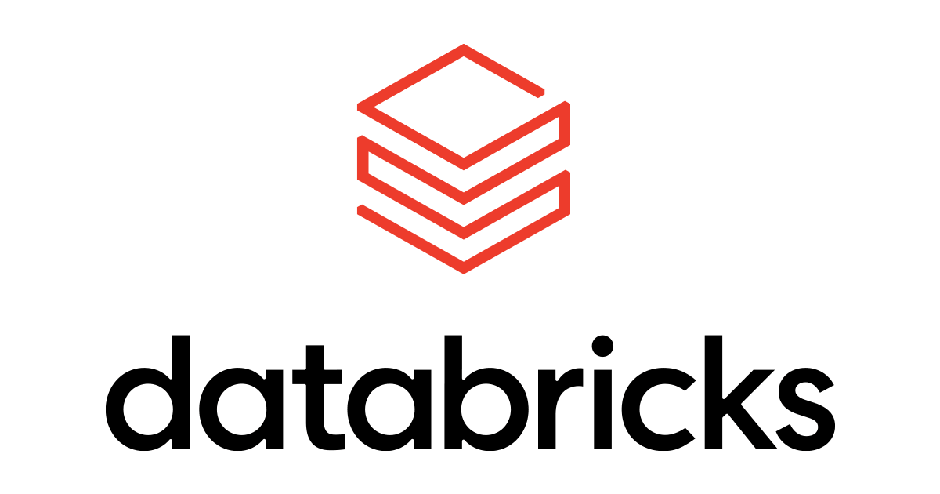


Topic 4 of 6
Proposed Architecture
Backend
Analytics
Frontend
06
Daily Reports
01
02
Cloud Platform
Data Orchestration
03
Analysis
Visualization and daily reports using Power BI
07
Real-time updates
Data from multiple sources collated on Microsoft Azure
Data Orchestration and pipeline building using Azure Data Factory
Data Orchestration and pipeline building using Azure Data Factory
Analysis done using Python or Spark on Databricks
Can the customers be given a portable option to voice their opinion?
* The same can be replicated for Google Cloud Platform / Amazon Web Services stack
Notes:
Source: https://databricks.com/blog/2020/08/20/modern-industrial-iot-analytics-on-azure-part-3.html

Slide 7
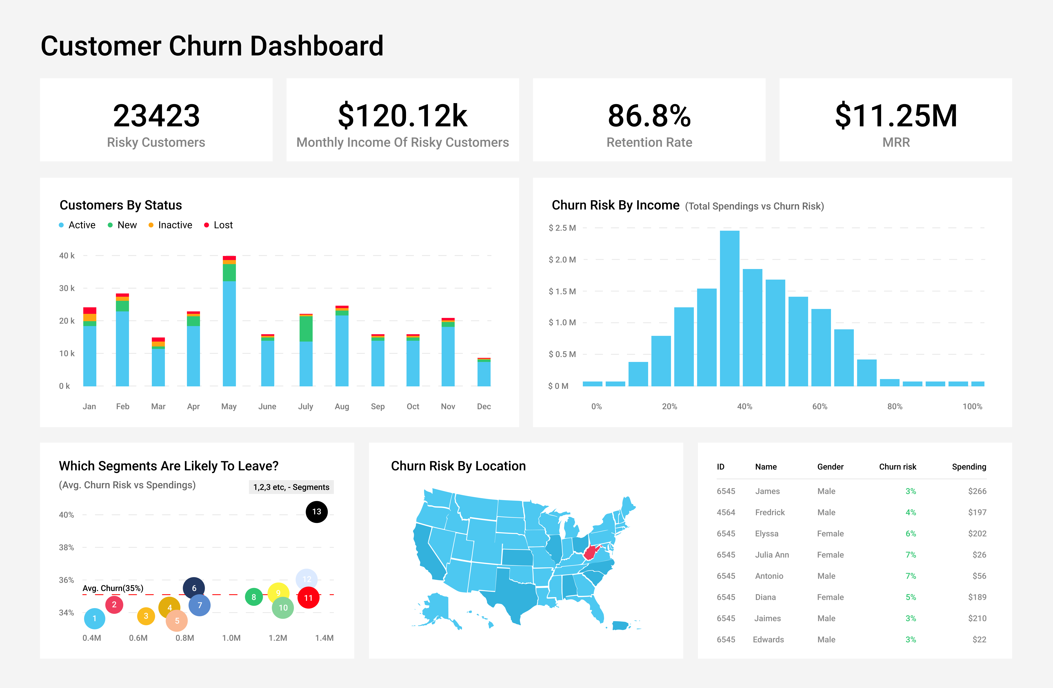
Topic 4 of 6
Dashboard
Illustrative
Notes:
Source: https://databricks.com/blog/2020/08/20/modern-industrial-iot-analytics-on-azure-part-3.html

Slide 8
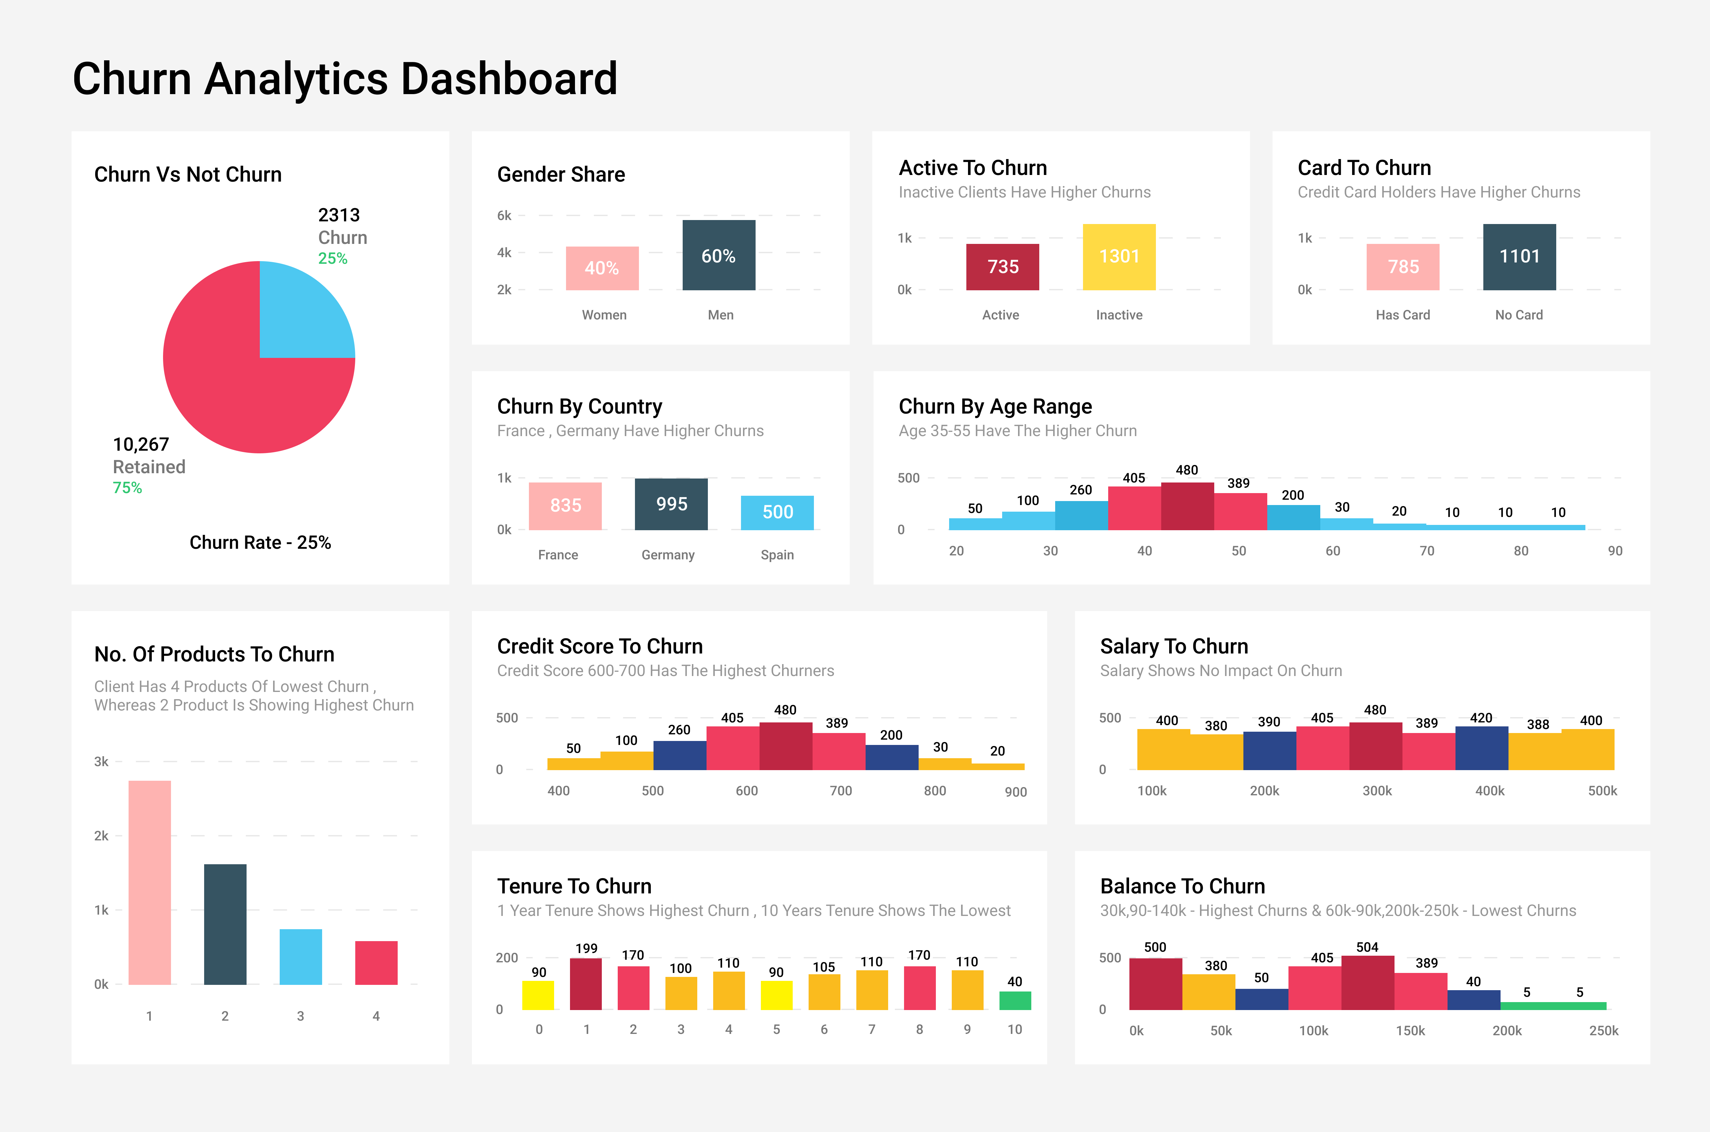
Topic 4 of 6
Dashboard
Illustrative
Notes:
Source: https://databricks.com/blog/2020/08/20/modern-industrial-iot-analytics-on-azure-part-3.html

Slide 9







Topic 5 of 6
Possible solutions to reduce customer churn
Phase I: Data Gathering
Phase II: Customer Segmentation
Phase III: Target Marketing
1 Personalized
customer profiles
6 Referral points for the
most loyal customers
2 Efficient interactions with customers
5 Classify customers
efficiently for loyalty card
3 Retention of customers based
on efficient segmentation
4 Identify causes and reduce return rates
Notes:
Spend on categories
AOV
Frequency of visits
Time of visits
Demographics
Gifting?
Birthday / Anniversary
Holiday Spends
Salary Range

Slide 10
Topic 6 of 6
Key Takeaways
01
The approach to move from current state to desired future state
02
Representation and analysis of the hypotheses
03
Proposed architecture
04
Possible solution implementations for the platform

Slide 11

Split Shipments
Case Study
Anish Mahapatra
Discussion Session
Anish Mahapatra anishmahapatra01@gmail.com

Slide 12
Retail Customer Churn
Case Study
Anish Mahapatra | 07 April, 2022
Thank you.

Slide 13
Questions
01
What are the channels that the retailer is looking to do customer retention?
04
What is the type of campaigns being run?
02
What are the best and worst selling products of the retailer and why?
05
What is the current technology stack being leveraged to manage, store and analyze data?
03
Who is the competition and what are the various strategies being implemented across various channels?
06
What are some of the ways that the business has tried to optimize customer retention strategies?

